Slide 1





In the beginning, there was management

Slide 2


But management was confused

Slide 3
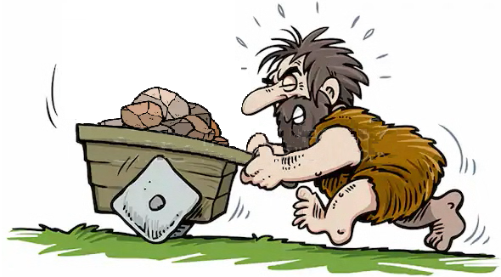

Slide 4
So management said…
LET THERE BE A SOLUTION!!!

Slide 5

DevOps heard from above and said…
WE NEED A SOLUTION!!!

Slide 6
MAKE IT SO!!
And decried

Slide 7

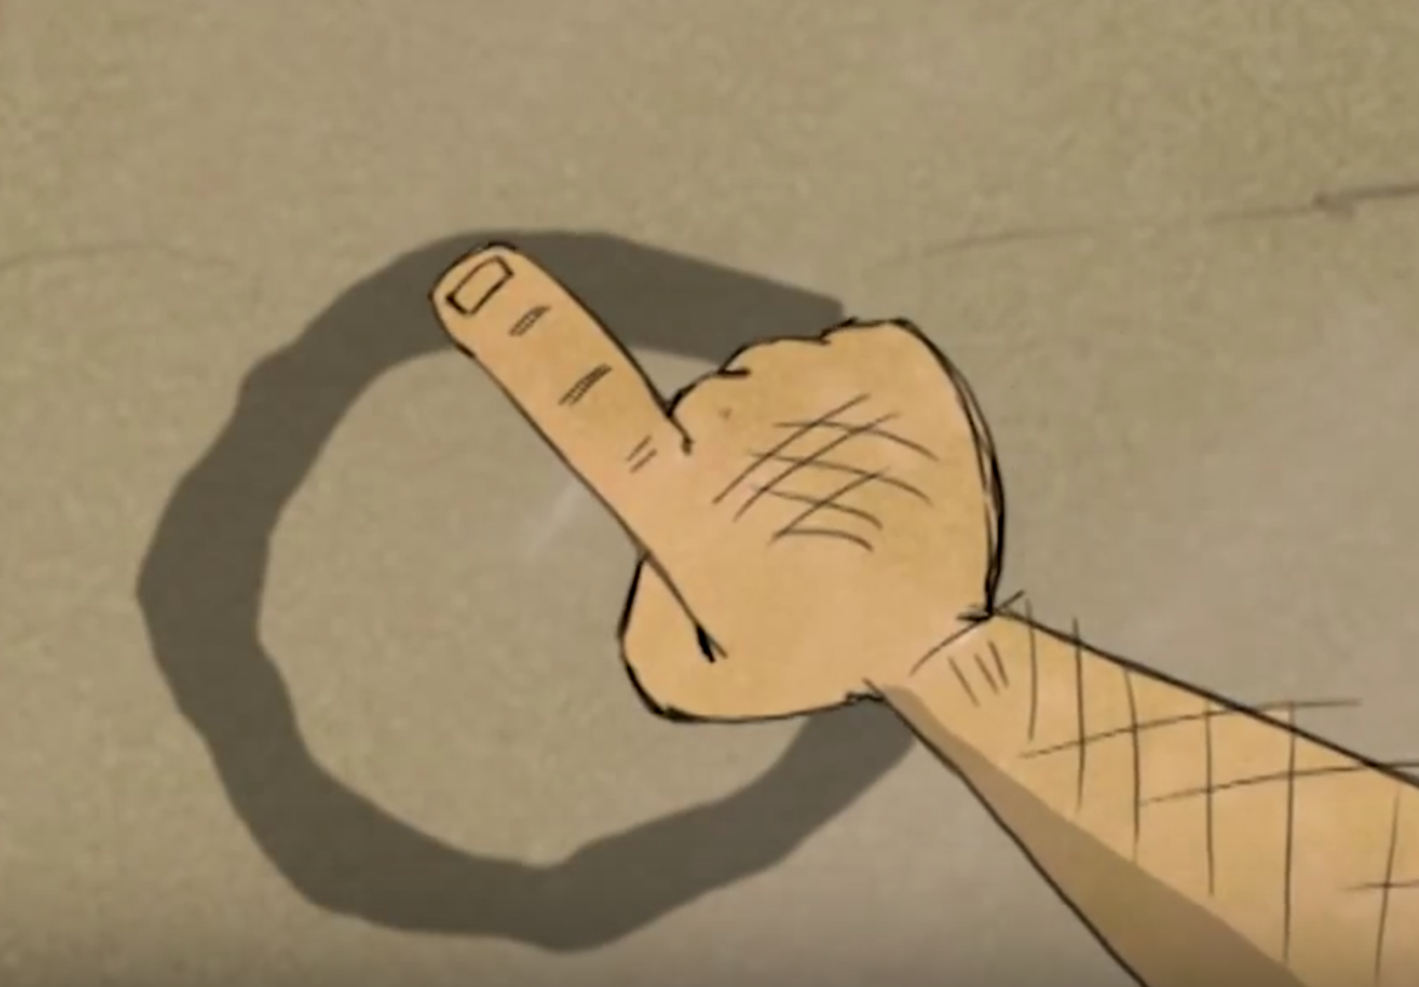
The Solutions Analyst and Systems Architect Were Empowered And So Devised a Plan

Slide 8
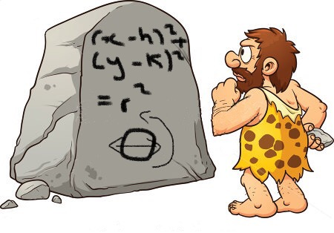
And the Plan was good

Slide 9

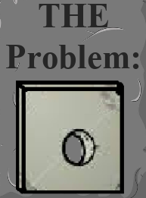
The Programmers and Testers
Heard about the plan and it was Named…

Slide 10

The Programmers and Testers
Heard about the plan and it was Named…

Slide 11

Administration
Was Given the Solution
Set out in the world
And Deployed it

Slide 12


Slide 17

The Users Tried the Solution
And they were Happy

Slide 18

And Management Smiled

Slide 19
Credits
The Solution
Presentation Design
Graphics Design Voices
Narrator:
Management:
DevOps Engineer and Systems Architect:
By Robin Melanson
By Raquel Melanson
Raquel Melanson and Robin Melanson
Raquel Melanson
Robin Melanson
Alina Melanson

